Slide 1
Object Oriented Programming
Lecture 2

Slide 2
Object-Oriented Programming
Object-oriented programming is centered on creating objects rather than procedures.
Objects are a melding of data and procedures that manipulate that data.
Data in an object are known as attributes.
Procedures in an object are known as methods.

Slide 3
Object-Oriented Programming
Object
Attributes (data)
Methods (behaviors / procedures)

Slide 4
Example of Object Oriented Model
Person
Car
Table
Class Room

Slide 5
Introduction to C++ program
//include headers; these are modules that include functions that you may use in your
//program; we will almost always need to include the header that
// defines cin and cout; the header is called iostream.h
#include <iostream.h>
int main() {
//variable declaration
//read values input from user
//computation and print output to user
return 0;
}
After you write a C++ program you compile it; that is, you run a program called compiler that checks whether the program follows the C++ syntax

Slide 6
Notes
what follows after // on the same line is considered comment
indentation is for the convenience of the reader; compiler ignores all spaces and new line ; the delimiter for the compiler is the semicolon
all statements ended by semicolon
Lower vs. upper case matters!!
Void is different than void
Main is different that main

Slide 7
The infamous Hello world program
When learning a new language, the first program people usually write is one that salutes the world :)
Here is the Hello world program in C++.
#include <iostream.h>
int main() {
cout << “Hello world!”;
return 0;
}

Slide 8
Variable declaration
type variable-name;
Meaning: variable <variable-name> will be a variable of type <type>
Where type can be:
int //integer
double //real number
char //character
float
Example:
int integer = 0;
short s_integer = 0;
long l_integer = 0;
unsigned int u_integer = 0;

Slide 9
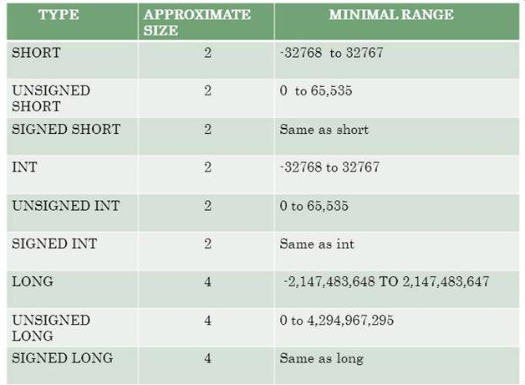
Different Datatype ranges

Slide 10
Input statements
cin >> variable-name;
Meaning: read the value of the variable called <variable-name> from the user
Example:
cin >> a;
cin >> b >> c;
cin >> x;
cin >> my-character;

Slide 11
Output statements
cout << variable-name;
Meaning: print the value of variable <variable-name> to the user
cout << “any message “;
Meaning: print the message within quotes to the user
cout << endl;
Meaning: print a new line
Example:
cout<<"The value of integer is: "<<integer<<"\n";
cout<<"The value of integer is: "<<integer<<endl<<endl;
printf("The value of integer is: %i\n", integer);
printf("The value of integer is: %d\n", integer);

Slide 12
If statements
if (condition) {
S1;
}
else {
S2;
}
S3;
True
False
condition
S1
S2
S3

Slide 13
Boolean conditions
..are built using
Comparison operators
== equal
!= not equal
< less than
> greater than
<= less than or equal
>= greater than or equal
Boolean operators
&& and
|| or
! not

Slide 14
Examples
Assume we declared the following variables:
int a = 2, b=5, c=10;
Here are some examples of boolean conditions we can use:
if (a == b) …
if (a != b) …
if (a <= b+c) …
if(a <= b) && (b <= c) …
if !((a < b) && (b<c)) …

Slide 15
If example
#include <iostream.h>
void main() {
int a,b,c;
cin >> a >> b >> c;
if (a <=b) {
cout << “min is “ << a << endl;
}
else {
cout << “ min is “ << b << endl;
}
cout << “happy now?” << endl;
}

Slide 16
While statements
True
False
while (condition) {
S1;
}
S2;
condition
S1
S2

Slide 17
While example
//read 100 numbers from the user and output their sum
#include <iostream.h>
void main() {
int i, sum, x;
sum=0;
i=1;
while (i <= 100) {
cin >> x;
sum = sum + x;
i = i+1;
}
cout << “sum is “ << sum << endl;
}

Slide 18
For Loop
It is used for fixed number of iterations
int i = 0;
cout<<"Continuous series"<<endl;
for (i = 0; i<20; i++)
{
cout<<i<<" ";
}
cout<<endl;

Slide 19
DoWhile
Similar to while but it executes at least once.
The condition is checked afterwards

Slide 20
Example
char choice = 'y';
int runs = 0;
int totalRuns = 0;
srand (time(NULL));
do
{ runs = rand() % 7;
if (runs == 5)
{
runs = 0;
cout<<"Out!"<<endl;
cout<<"Total Runs Scored = "<<totalRuns<<endl;
totalRuns = 0;
cout<<"Do you want to try again?\nEnter 'y' for yes and 'n' for no\n";
cin>>choice;
if(choice == 'y') //What happens if we put brackets or not. If not, only one statement is executed
continue; //Recommendation: Always put brackets
}
else
{
cout<<"Runs scored = "<<runs<<endl;
totalRuns = totalRuns + runs;
}
}while(choice != 'n' );

Slide 21
srand function in C++
Initialize random number generator
The pseudo-random number generator is initialized using the argument passed as seed.
If seed is set to 1, the generator is reinitialized to its initial value and produces the same values as before any call to rand or srand. In order to generate random-like numbers, srand is usually initialized to some distinctive runtime value, like the value returned by function time (declared in header <ctime>). This is distinctive enough for most trivial randomization needs.

Slide 22
Example
srand (time(NULL));
//see what effects it has after uncommenting it
int random = rand() % 10;
cout<<"\nGenerated random number is: "<<random<<endl;

Slide 23
Exercise
Write a program that asks the user
Do you want to use this program? (y/n)
If the user says ‘y’ then the program terminates
If the user says ‘n’ then the program asks
Are you really sure you do not want to use this program? (y/n)
If the user says ‘n’ it terminates, otherwise it prints again the message
Are you really really sure you do not want to use this program? (y/n)
And so on, every time adding one more “really”.

